Slide 1
Welcome Year 8
Today’s theme for our assembly is
“Keeping in touch”

Slide 2
Year Group Changes
“Thank you for making my time as your Head of Year so enjoyable. It has been an absolute pleasure working with each and every one of you. I wish you the very best of luck in all that you do” - Miss Rose
Head of Year – Miss Reid (lre@sydneyrussellschool.com)
Deputy Head of Year – Miss Agyei (eaa@sydneyrussellschool.com)

Slide 3
Microsoft Teams
Check all subjects daily
Teachers will set work on a Monday
Deadline for all work is on a Friday
Remember, Teams is for work purposes only
It can be used on the web or downloaded as an app
Additional useful resources
The Oak National Academy Trust
https://www.thenational.academy/online-classroom
BBC Bitesize
https://www.bbc.co.uk/bitesize

Slide 4
Tips for working at home
Plan your day
Find a quiet place to work
Let people in your household know you are working
Set hours and stick to them
Reward yourself

Slide 5
Scenarios - FAQ
-How do I reset my password?
-How do I contact my teachers?
-When will I find out my options for Year 9?
-What happens if I don’t complete my work?
-When will school open again?

Slide 6
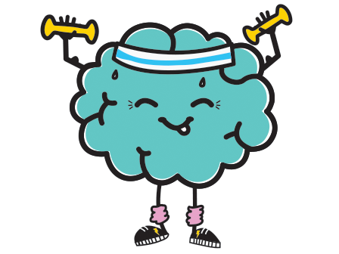
Staying Healthy
Keep in touch
Don't bottle things up
Routine
Exercise
Healthy eating
Walking
Washing and grooming
Develop a new interest or hobby.
Notes:
Keep in touch with family and friends to make sure that you still have that social connection with people during lockdown.
Don't bottle things up - It can be a really difficult time at the moment during lockdown with lots of different emotions going on, it will be even more difficult if you keep everything in and don't talk about how you feel sometimes.
Routine - Have a daily routine even if it's just one thing that you do everyday e.g. work in the mornings between 10-11. It will help you become more grounded and give you a better sense of structure.
Give each other some space - If you are in lockdown and sharing a bedroom with multiple siblings or don't have much privacy in your house/flat it's important to remember that sometimes when you spend lots of time in a confined space with the same people all the time it is normal to be frustrated sometimes, just make sure you give each other personal space and have times where you can be on your own.
Exercise - Although it's harder at the moment, all you need is a garden or just some space on the floor and you can do daily exercises which have been proven to reduce stress and lift moods. You can go online and there are lots of things for home workouts that you can look at or workouts that require no equipment to use.
Healthy eating - What we eat and put it our bodies can have a big effect on how we feel, make sure that you are drinking enough water and not only eating foods that are bad for you as this may be the reason why you sometimes feel you have low energy and motivation to do things.
Walking - If appropriate and following the social distancing guidelines going out for morning walks is a great way of clearing your mind and relaxing you for the day.
Washing and grooming yourself in the mornings. Waking up having a shower and getting ready as if you were going out that day can help put you in a more productive mind-set towards doing work
Making a to do list every morning. Even just one task a day that you can complete, you can keep it small and easy to accomplish at first. It will give you a sense of accomplishment every time you complete a task
Develop a new interest or hobby. This can be a great way to keep yourself busy and learn something new at the same time.

Slide 7
Culture capital
For many, the lockdown has given the gift of time. This may be a couple of extra hours that would usually be spent commuting from home to school and vice versa or it may be the entire school day.
This time can be used productively to achieve your personal development goals and expand your horizons. Whether your goals are to learn a language, visit a museum, reading and writing, or learn a musical instrument, now is the ideal time to start. Links will be available to you in due course.

Slide 8
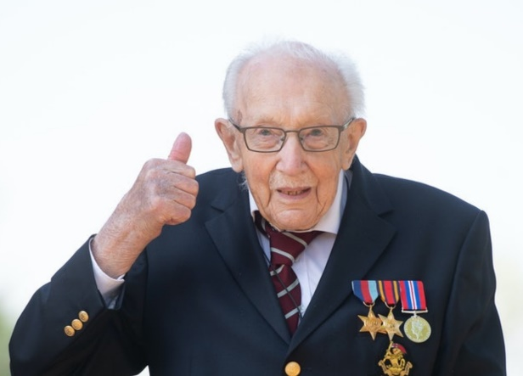
National Hero
Thomas Moore is a former British Army officer known for his achievements raising money for charity in the run-up to his 100th birthday during the COVID-19 pandemic.
On 6 April 2020, he began to walk laps of his garden in aid of NHS Charities Together, with the aim of reaching 100 laps by his 100th birthday.
Thomas Moore completed 100 laps of his garden which encouraged millions of people to sponsored him and he has managed to raise over £32 million for the NHS.
He has received over 150,000 thank you cards, and was appointed as honorary colonel of the Army Foundation College.

Slide 9
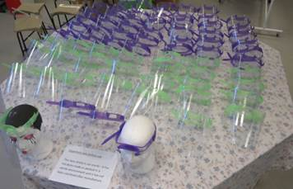
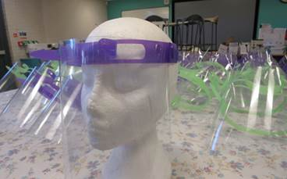
SRS heroes…
Ms McArthur has been busy sewing scrubs (bottoms and tops) for our NHS workers at Queen’s Hospital.
Mr Prince and Mr Dunn have been busy designing and producing protective masks for our hospital workers.
338 pairs of goggles and protective masks from our Science and Art departments were donated to our frontline hospital staff.

Slide 10
“Kindness begins with me”

Slide 11
Useful links
- How do I reset my password?
http://217.179.210.29/helpdesk/user/portal/homepin.asp
- How to access Microsoft Teams?
Type into Google ‘Office 365’
Click ‘Office 365 login’ which is the first link that appears
Log in using your school email and password
Click the purple Teams icon

