Slide 1
Microsoft TEAMs
Accessing your work from home

Slide 2
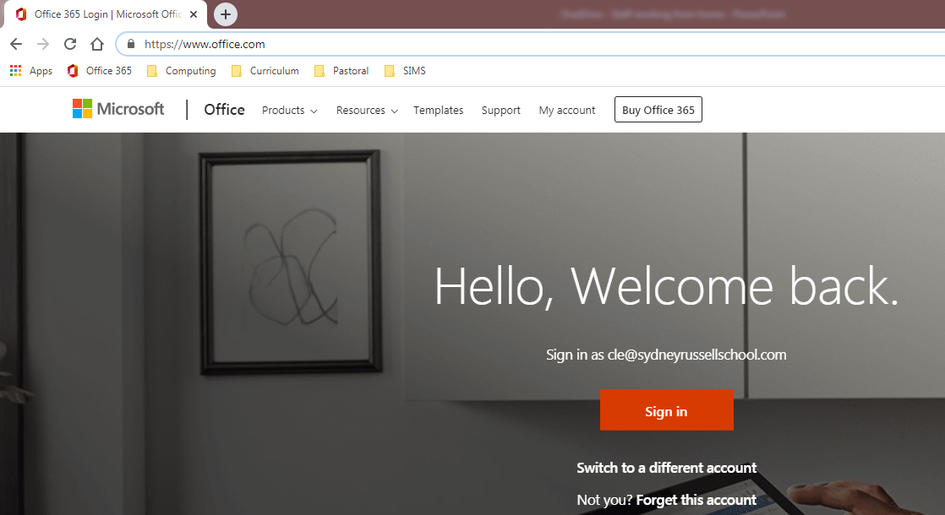

1
Go to the Microsoft Office 365 website.
https://www.office.com/
2
Click ‘Sign In’ and use your school email and password to gain access. (It will be your username that you use to login to the school’s network followed by @sydneyrussellschool.com

Slide 3
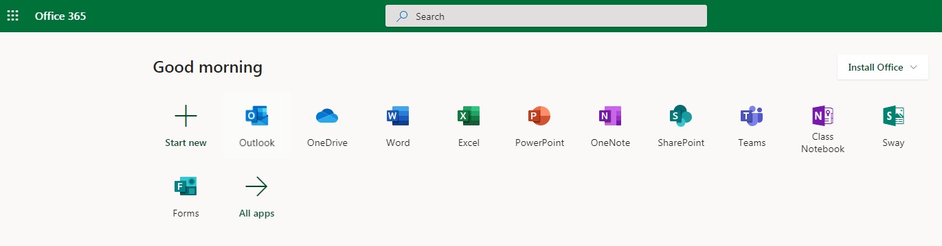
3
Once you have successfully logged in, you will be presented with all of the Office 365 Applications.
4
Select ‘Teams’.

Slide 4
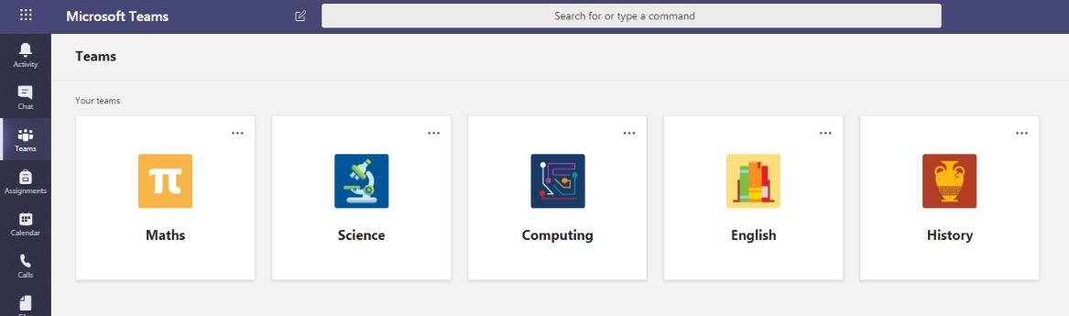
5
You are now inside the Teams Area
6
When you click on a subject it will take you to your group.
REMEMBER: This space has been created to communicate with your teachers and to use the resources provided. THIS IS NOT TO BE USED FOR ANYTHING OTHER THAN SCHOOL PURPOSES.

Slide 5
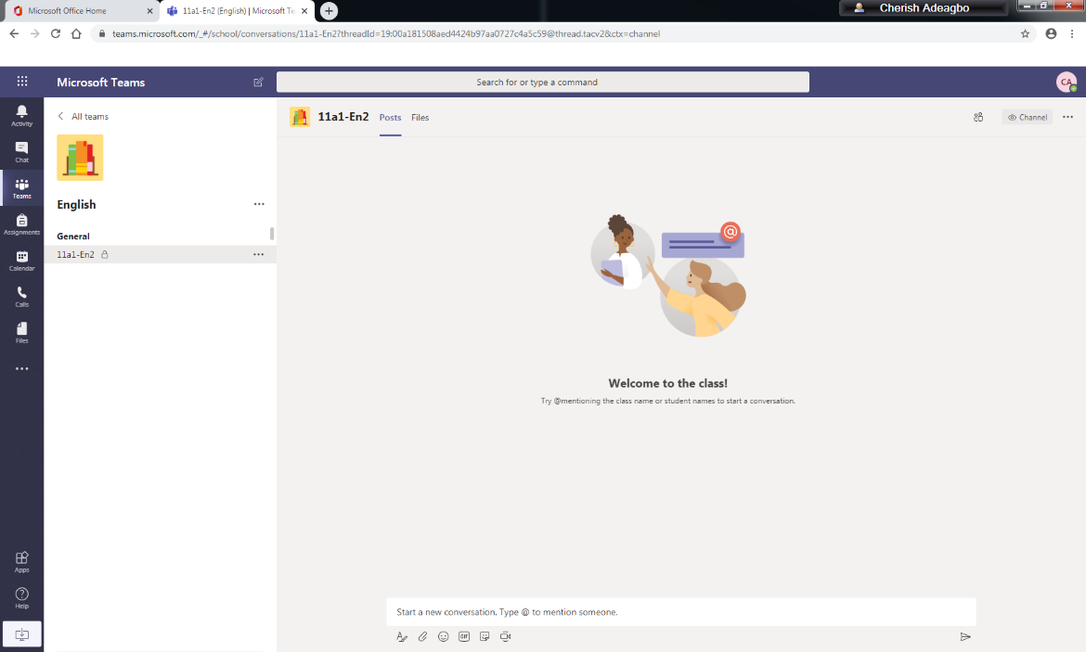
Files uploaded by the teacher can be accessed here.
This is the class you have been assigned to.
If you wish to communicate with your teacher, you can post your message here.

Slide 6
OneDrive
Your documents in the cloud

Slide 7
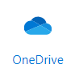
Once you have successfully logged in, you will be presented with all of the Office 365 Applications.
Select ‘OneDrive’.

Slide 8
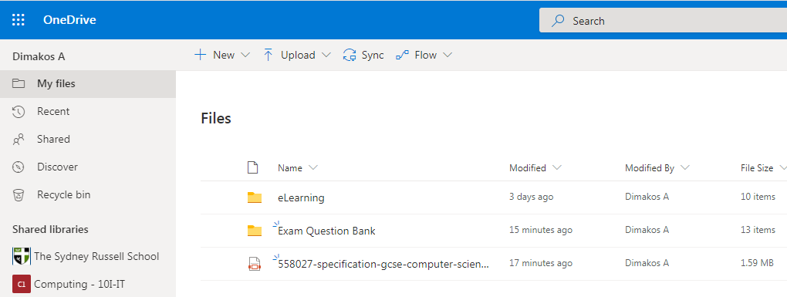
Click New to create a new file or folder or Click Upload to upload files/folders. This area is your own Documents area,
Use this area to Save all your homework, tasks and activities set by your teachers, keep it organised.

Slide 9
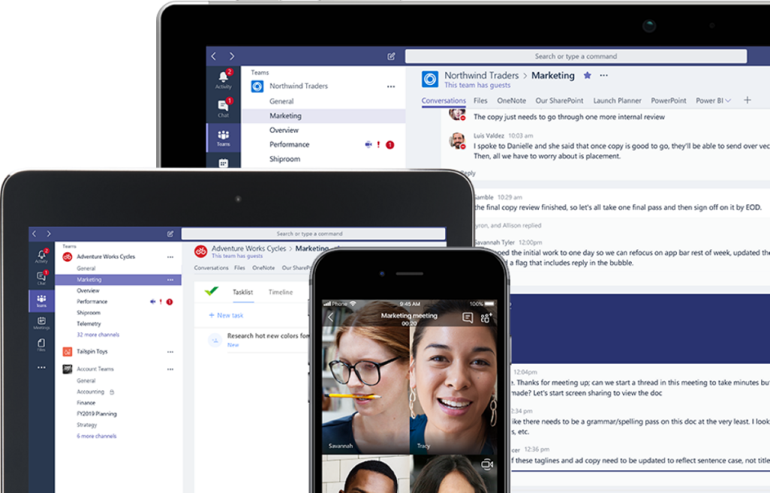
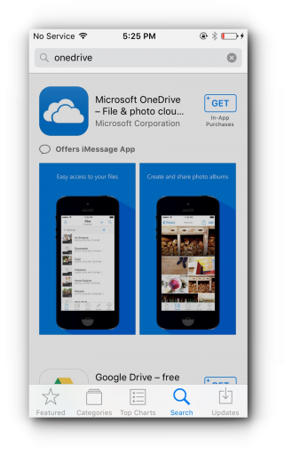
OneDrive and TEAMs can also be accessed via a Mobile Device
OneDrive & Teams can also be accessed via mobile devices by downloading the appropriate Application.
Note: Any changes made to documents in OneDrive will not automatically be updated in your school folders. You will need to transfer them back into ‘My Documents’ when you return to school.

